Slide 1

Credit Card
Default Prediction
Group 2:
Theng Foo Yin | Lim Gabriel | Ng Yew Kong
Chai Si Ting | Ho Faye

Slide 2
Content Overview
01
Introduction and Problem Statement
02
Exploratory Data Analysis
03
Feature Engineering
04
Models
05
Business Insights and Solution
2

Slide 3
Introduction and Problem Statement
With globalization and concerns over Covid-19 being transmitted through contaminated surfaces, contactless payments have been made the new norm. Credit cards usage has also accelerated significantly through near field communications (NFC) cards, phone apps and wearables, providing both convenience and easy accessibility for usage.
This change in living behaviour, in turn, put card issuers like banks at risk of credit card delinquencies, especially during poor or uncertain economic environment.
To reduce the susceptibility of banks with a hefty write-down on outstanding balances left unpaid, AI modeling can provide solutions to better predict potential credit card defaults, and help identifying key factors leading to a default.
Introduction & Problem Statement
Exploratory Data Analysis
Feature Engineering
Models
Business Insights & Conclusion
3

Slide 4
Objectives
In order to reduce the risk of banks’ exposure in large credit card default incidents, utilize various data classification techniques with a large data set of customer records to screen for potential credit card defaulters.
Identify common key traits, features and conditions through the pool of customers’ dataset for early detection and trigger for preventive measures.
To avoid experiencing customer defaults with a snow-balling effect, derive accurate predictions and recommendations of test results to flag for default accounts in advance.
Introduction & Problem Statement
Exploratory Data Analysis
Feature Engineering
Models
Business Insights & Conclusion
3

Slide 5
EDA - Data Visualisation
Exploratory data analysis (EDA) - approach of analyzing data using statistical graphics and data visualization methods.
Target Variable:
Default Rate
Independent Variable 1:
Credit Limit
Independent Variable 2:
Age
Independent Variable 3:
Gender
Independent Variable 4:
Education
Independent Variable 5:
Outstanding Debt
Introduction & Problem Statement
Exploratory Data Analysis
Feature Engineering
Models
Business Insights & Conclusion
3
Notes:
EDA process: we generated a summary statistics data and created various of Bar charts, boxplots, distribution graphs to understand the data better. So that we can discover patterns, outliers, check for any missing/incomplete features. and then replace/remove it or what we call Data cleaning. Begin with setting Default Rate as target variable

Slide 6
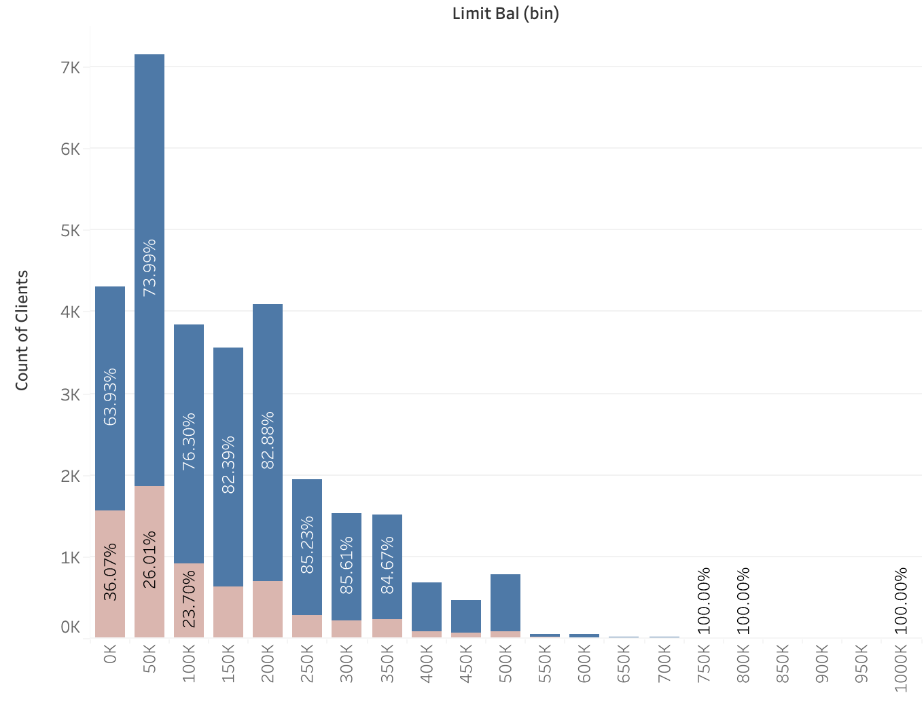

Data Visualisation - Credit Limit
Clients with <50K credit limit have the highest default rate at 36.07%
This is 10% higher than the next closest bucket of clients with 50K - 100K credit available
Introduction & Problem Statement
Exploratory Data Analysis
Feature Engineering
Models
Business Insights & Conclusion
3

Slide 7
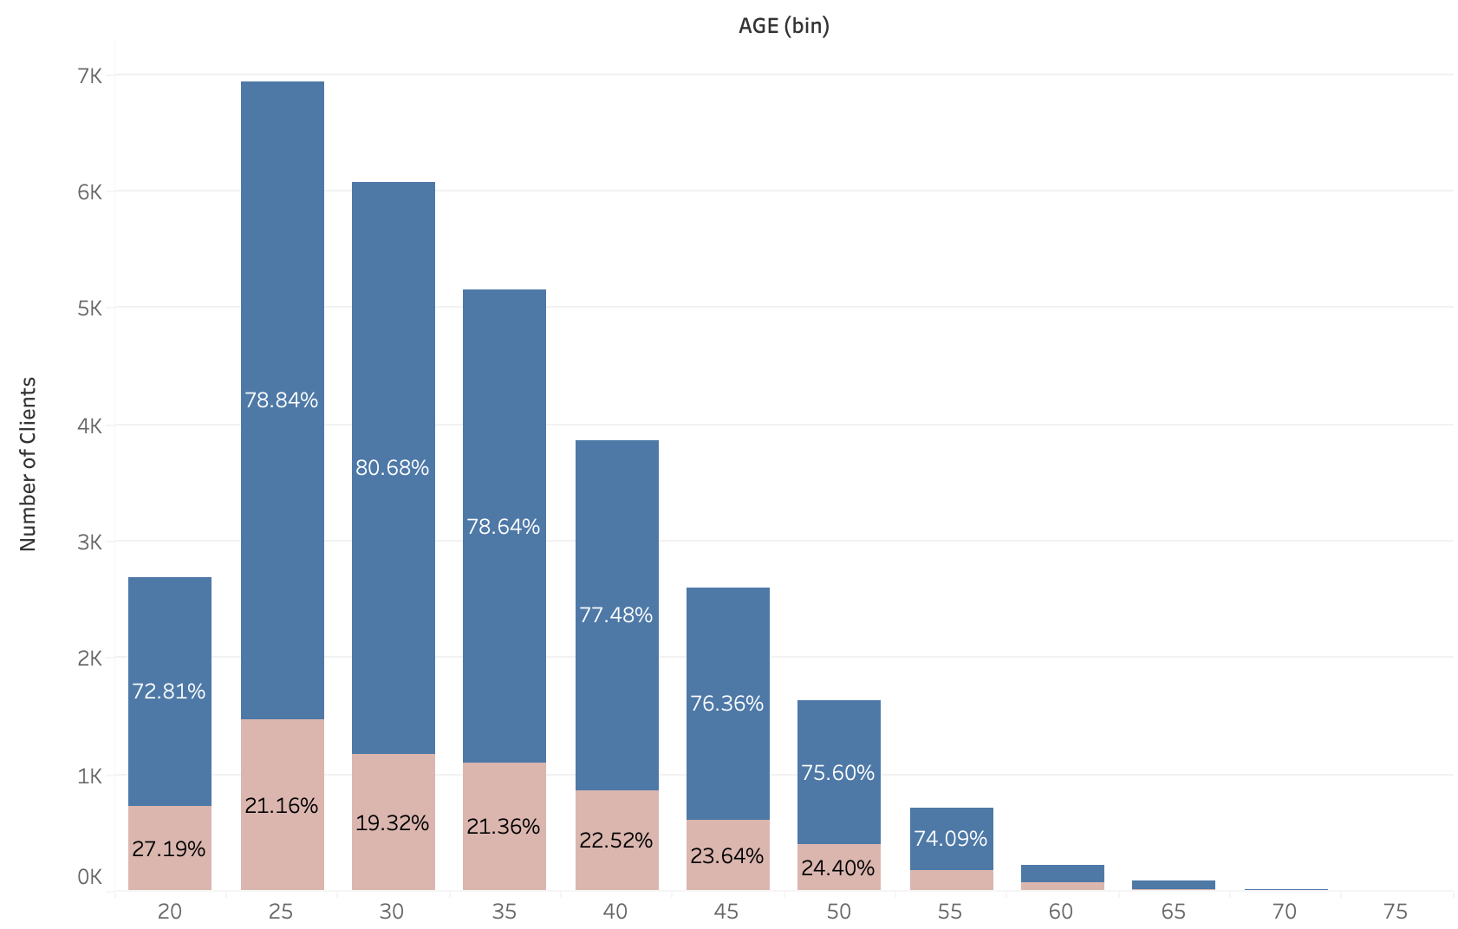
Data Visualisation - Age
22.12% of customers in the dataset defaulted on their loans within the 7 month period on record.
Age group 25-29 have the highest defaulted.
Introduction & Problem Statement
Exploratory Data Analysis
Feature Engineering
Models
Business Insights & Conclusion
3

Slide 8
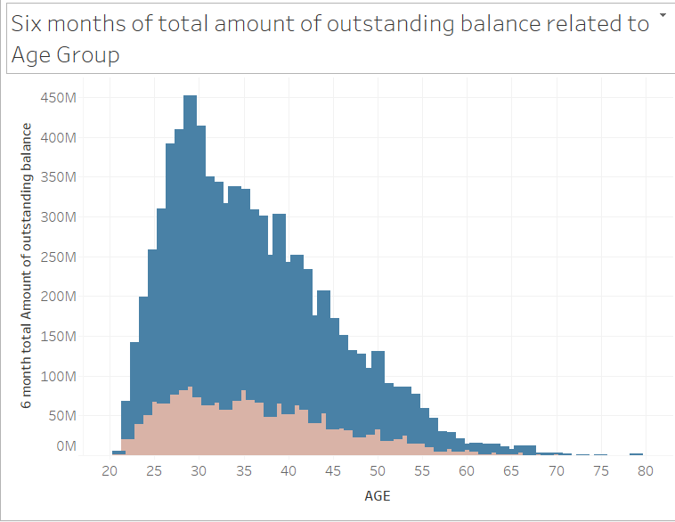
Data Visualisation - Six months Outstanding Debt
Clients age group between 28 to 30 tend to have higher 6 months outstanding loan than the rest of the age group.
It shown that clients spending decline after age 30.
Credit card default amount also start to decline after age 30.
Introduction
Exploratory Data Analysis
Feature Engineering
Models
Business Insights & Conclusion
3
Introduction & Problem Statement

Slide 9
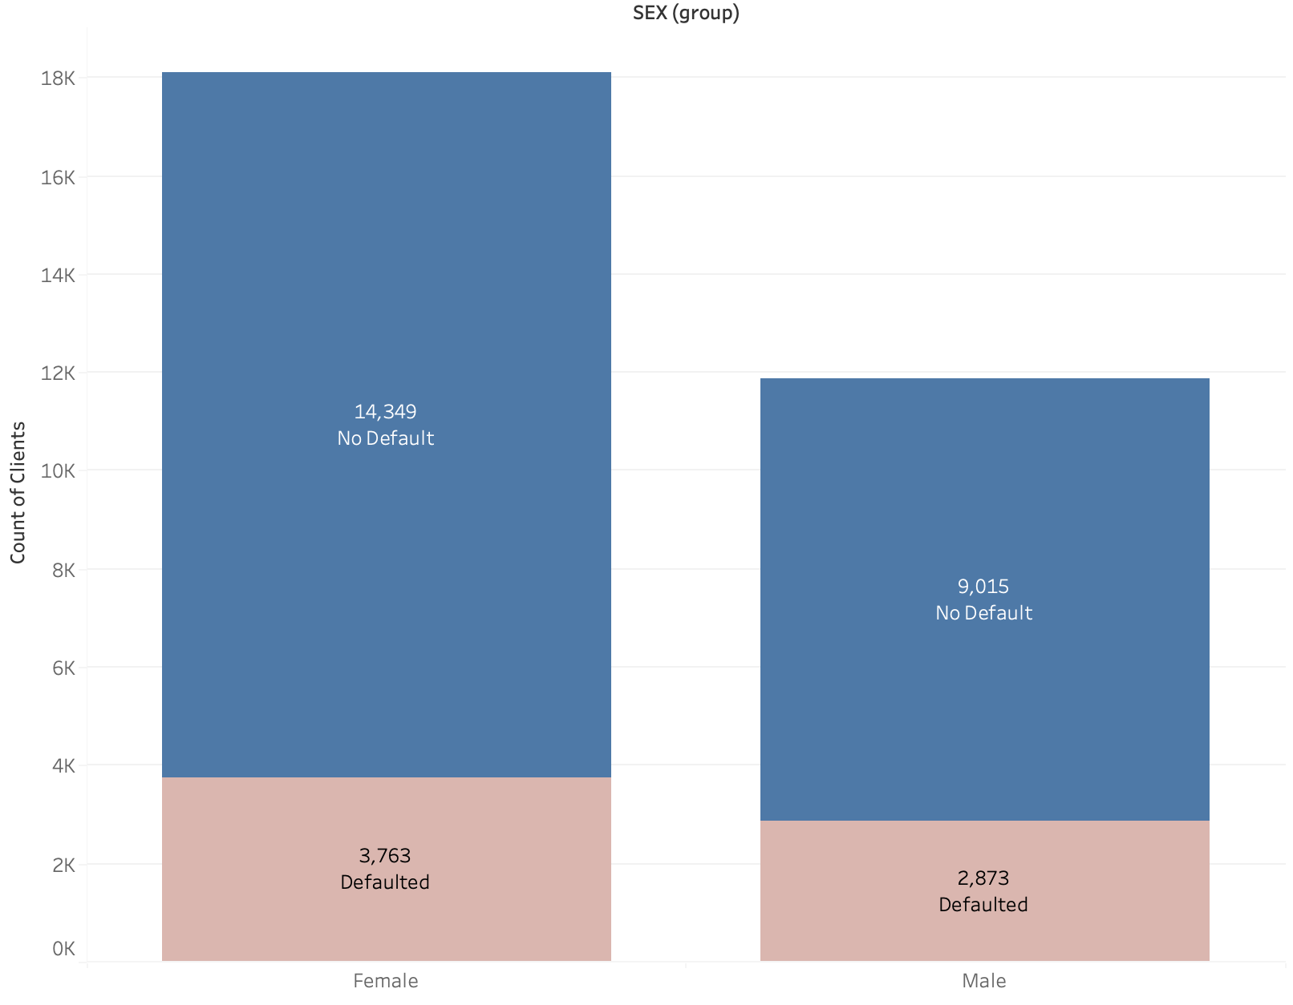
Data Visualisation - Gender
Females make up 60.37% of the clients in this dataset, despite that, they have a 3.37% lower default rate out of the set.
Gender is an important variable to consider when determining the overall chance of default.
Introduction & Problem Statement
Exploratory Data Analysis
Feature Engineering
Models
Business Insights & Conclusion
3

Slide 10
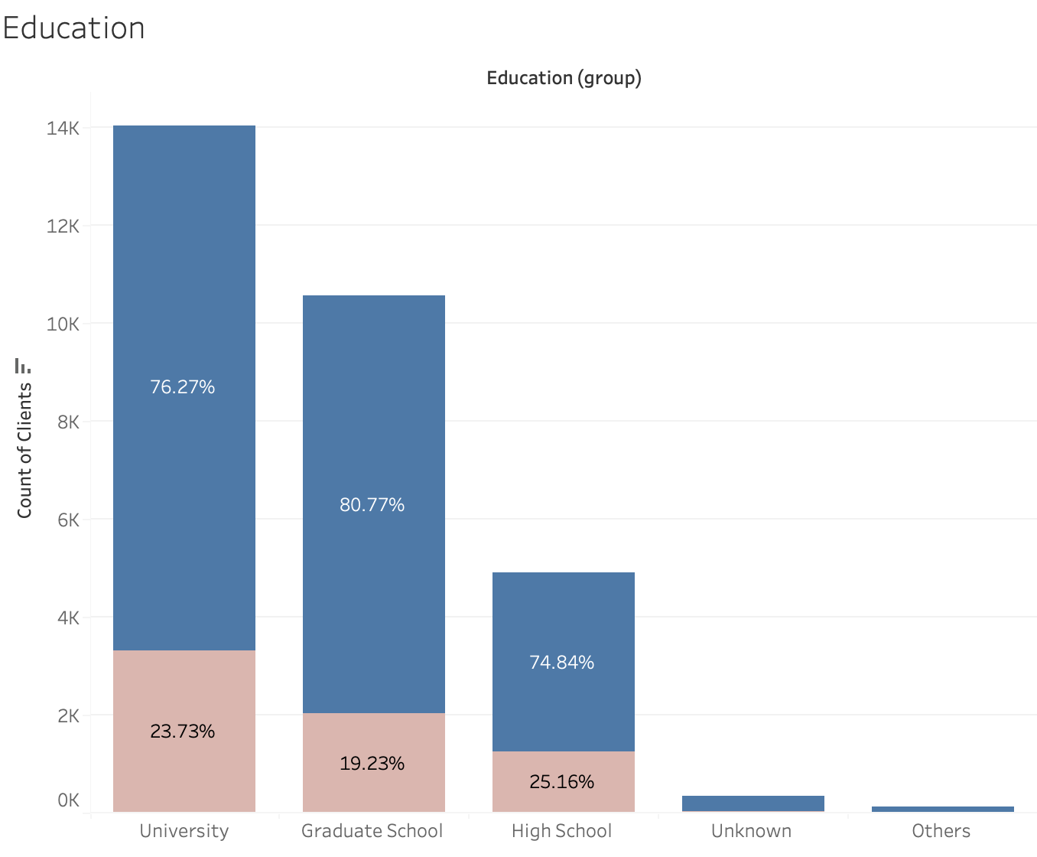
Data Visualisation - Education
Highest default percentage coming from high school background (25.16%)
Lowest coming from graduate school (19.23%).
Small percentage of unknown variables to be ignored for final result output.
Education has a significant contribution to Credit card default.
Introduction & Problem Statement
Exploratory Data Analysis
Feature Engineering
Models
Business Insights & Conclusion
3

Slide 11
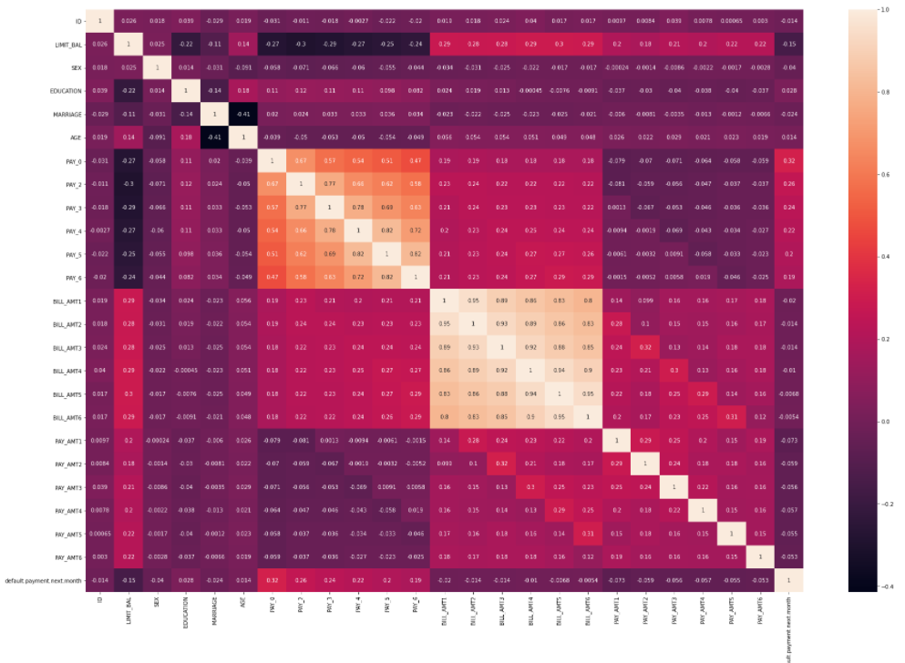
EDA - Data Cleaning and Correlation Heatmap
Repayment Status (PAY_0 to PAY 6) and Outstanding Balance (BILL_AMT 1 to BILL_AMT6) have the highest correlation within the dataset
This shows the importance of consistency of repayments when attaining the likelihood of default
Introduction
Exploratory Data Analysis
Feature Engineering
Models
Business Insights & Conclusion
3
Introduction & Problem Statement

Slide 12
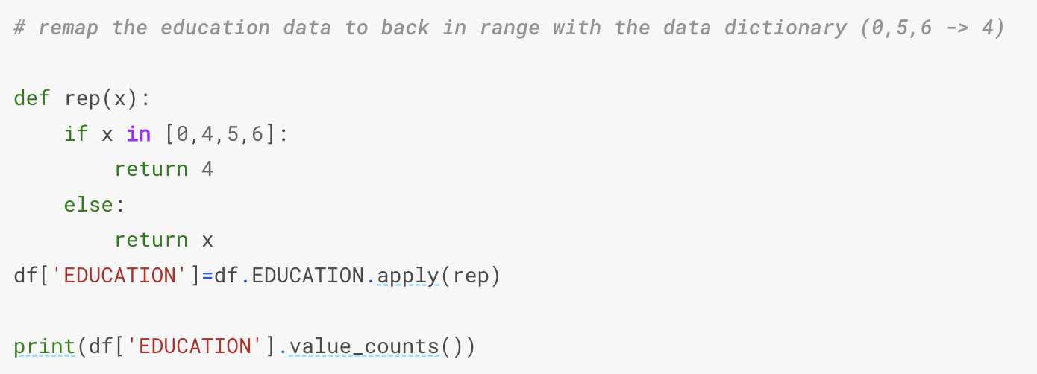
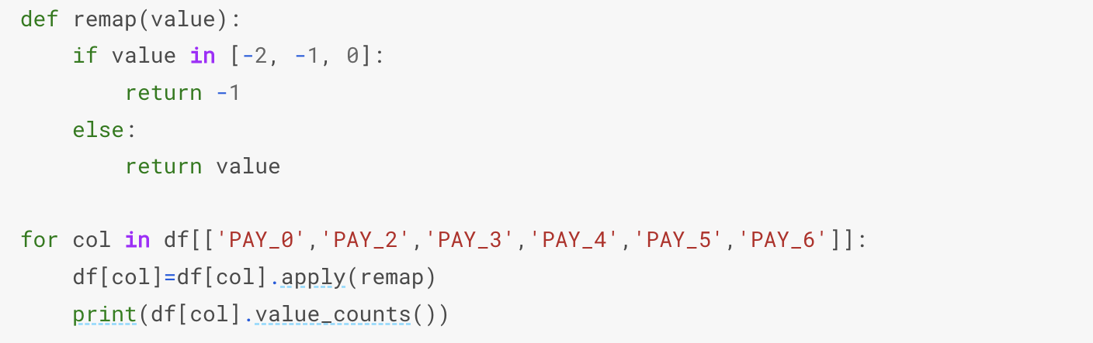
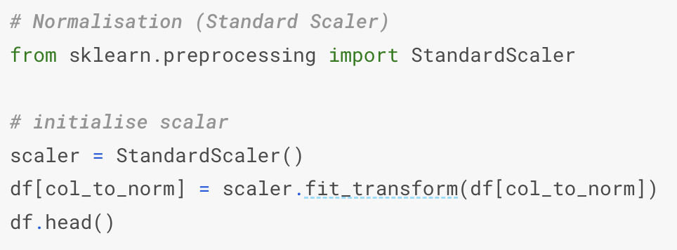
Feature Engineering
Remap
Education
Remap EDUCATION column: Unknown (0, 5, 6) with others (4) to group undefined values together (1.56% of dataset)
Remap
Pay
Remap PAY_0 - PAY6 column: Undefined values (0, -2) with pay duly (-1) to group successful payments together
Standard
Scalar
Normalising and scaling values to a standard range for ease of modeling
Introduction
Exploratory Data Analysis
Feature Engineering
Models
Business Insights & Conclusion
3
Introduction & Problem Statement

Slide 13
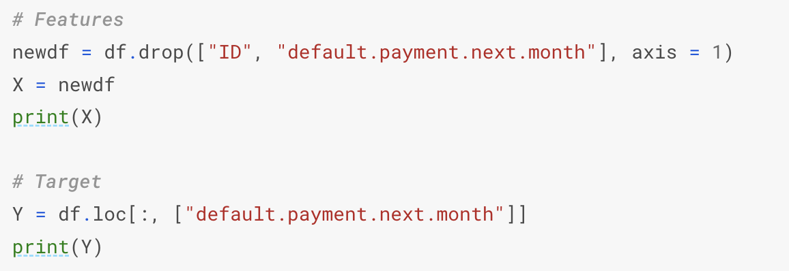
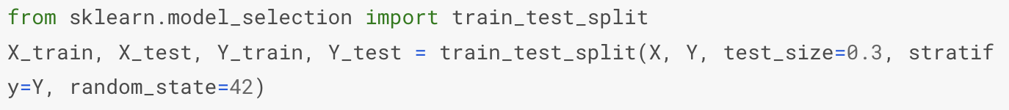
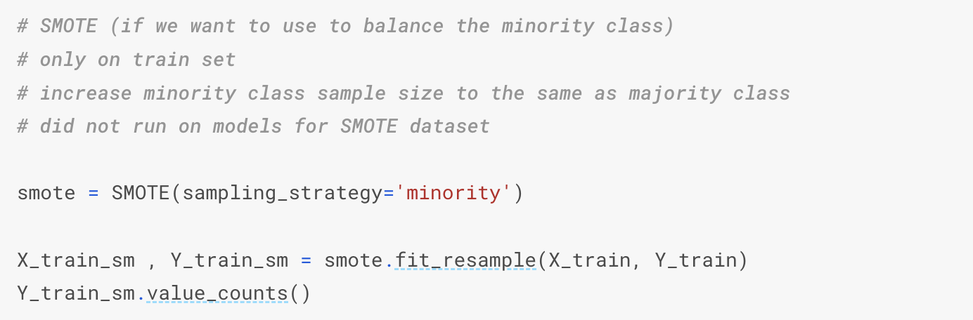
Feature Engineering
Feature
Selection
Identify our target and independent variables to build our models on, drop unnecessary column ID
Train-test
Split
Setting aside 30% of the total dataset (9,000 entries) to train our machine learning model
SMOTE
Increase sample size on training set to balance the minority class
Introduction
Exploratory Data Analysis
Feature Engineering
Models
Business Insights & Conclusion
3
Introduction & Problem Statement

Slide 14

Weaker Classifier
Stronger Classifier
Neural Network
Logistic Regression
To recognise hidden patterns and correlation in raw data, much like the brain, and then continuously learn and improve
To model the probability of certain class existing in binary or multiclass outputs
Random Forest
Decision Tree
Collection of multiple independent decision trees with single, aggregated result by majority voting
Tree-like model that makes predictions based on what was answered previously
K-Nearest Neighbours
XGBoost
Additive (sequential ensemble) model where a weak learner improves on past existing weak learners
A non-parametric supervised learning method used for classification and regression.
Introduction & Problem Statement
Exploratory Data Analysis
Feature Engineering
Models
Business Insights & Conclusion
3

Slide 15
Model Comparison
 | Logistic Regression | Decision Tree | Random Forest | XGBoost | Neural Network | K-Nearest Neighbours
F1 Score | 0.51 | 0.46 | 0.52 | 0.49 | 0.47 | 0.40
Precision | 0.47 | 0.40 | 0.50 | 0.56 | 0.39 | 0.35
Recall | 0.57 | 0.53 | 0.54 | 0.43 | 0.59 | 0.48
Random Forest is the best model based on F1 Score
XGBoost is the best model based on Precision
Neural Network is the best model based on Recall
Overall: Random Forest is the best model considering Precision VS Recall tradeoff
*F1 Score = 2 x (Precision x Recall) / (Precision + Recall)
Introduction & Problem Statement
Exploratory Data Analysis
Feature Engineering
Models
Business Insights & Conclusion
3

Slide 16
Model Comparison
 | Logistic Regression | Decision Tree | Random Forest | XGBoost | Neural Network | K-Nearest Neighbours
Accuracy (Train) | 0.708 | 0.883 | 0.893 | 0.995 | 0.796 | 1.000
Accuracy (Test) | 0.762 | 0.720 | 0.779 | 0.799 | 0.706 | 0.688
Overfitting in all Tree-based models and K-Nearest Neighbours model
Due to max depths of tree models (best parameter: max_depth = 14)
Different data distribution of Train-Test datasets after SMOTE
Logistic Regression & Neural Network model generalise better to unseen dataset
Logistic Regression model performs better on Test than Train set
XGBoost is the best model based on Accuracy (Test)
Introduction & Problem Statement
Exploratory Data Analysis
Feature Engineering
Models
Business Insights & Conclusion
3

Slide 17
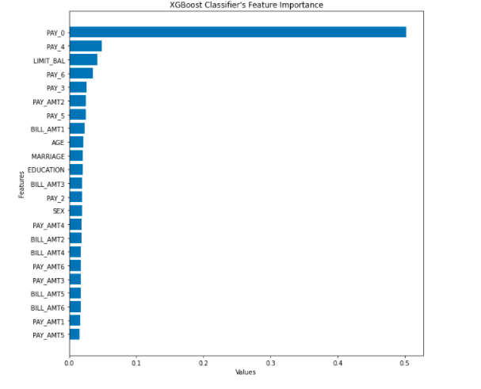
Feature Importance
XGBoost
Importance Feature
Pay_0: Repayment Status in September
LIMIT_BAL: Amount of credits given in NT dollars
PAY_AMT2: Amount of previous payment in August 2005
BILL_AMT_1: Amount of bill statement in Sept 2005
Age: Age in years
Because Pay_0, Pay_4, Pay_6 and Pay_5 are highly correlated
Introduction & Problem Statement
Exploratory Data Analysis
Feature Engineering
Models
Business Insights & Conclusion
3
Notes:
We choose XG boost because the test accuracy is the highest for XG boost
We found that for XG boost the top 5 distinct important features are
Pay_0
Pay_4
Lim_Bal
Pay_6
Pay_3
PayAmt_2
PAY 5
Bill Amount_1
Age

Slide 18
Business Insights
1
Bill Payment and Repayment Status
Clients age group between 28 to 30 tend to have higher outstanding loan than the rest of the age group
2
Credit Limit
Most clients undertake a loan credit of 50k
Clients with less than 50K have the highest defaulting rate
3
Age
Majority of the clients tend to be within the late 20s and early 30s range
Clients age 20-25 have the highest rate of defaulting
Introduction & Problem Statement
Exploratory Data Analysis
Feature Engineering
Models
Business Insights & Conclusion
3

Slide 19
Business Solution
More Stringent Checks
Timely Reminders
Offer incentives
Given that clients age 20-25 have the highest rate of defaulting, more checks should be done to determine their ability to repay the loans
Ascertain whether clients within this range have a steady flow of income to repay the loans
Add more variables such as asset ownership and occupation
Send more notifications to remind customers to pay
Once customers are flagged out to have a risk of default, provide incentives/reduce repayment amount to encourage early repayment
Offer debt restructuring plan
Introduction & Problem Statement
Exploratory Data Analysis
Feature Engineering
Models
Business Insights & Conclusion
3

Slide 20
The End

